Slide 1
Multivariate Analysis of Variance

Slide 2
Today . . .
  MANOVA—finding linear combinations that best separate groups (hey, wait a minute, didn’t we just . . .)
  Where does MANOVA fit among the other ways that a data set could be analyzed?
  How does MANOVA extend univariate approaches?

Slide 3
To explore these questions, consider the ways that the following data could be analyzed:
Participants are randomly assigned to one of four groups that get different kinds of training for taking tests: no training, standard paper-pencil training, computer-based training, and both standard training and computer-based training.
Following training, all participants complete a test of verbal ability and a test of quantitative ability in standard paper-and-pencil format and in computer format (all counterbalanced).

Slide 4
Within-Subjects
Standard
Standard
Standard
Computer
Computer
Computer
Computer
Measure of
Measure of
Measure of
Measure of
Measure of
Measure of
Measure of
Measure of
Verbal
Verbal
Quantitative
Quantitative
Verbal
Verbal
Quantitative
Quantitative
Ability
Ability
Ability
Ability
Ability
Ability
Ability
Ability
No Training
No Training
Standard
Standard
Training
Training
Only
Only
Between-Groups
Computer
Computer
Training
Training
Only
Only
Both
Both

Slide 5
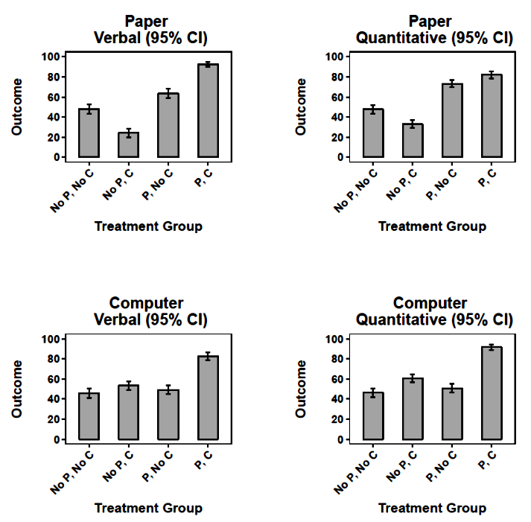
The groups appear to be different in their patterns of outcomes.

Slide 6
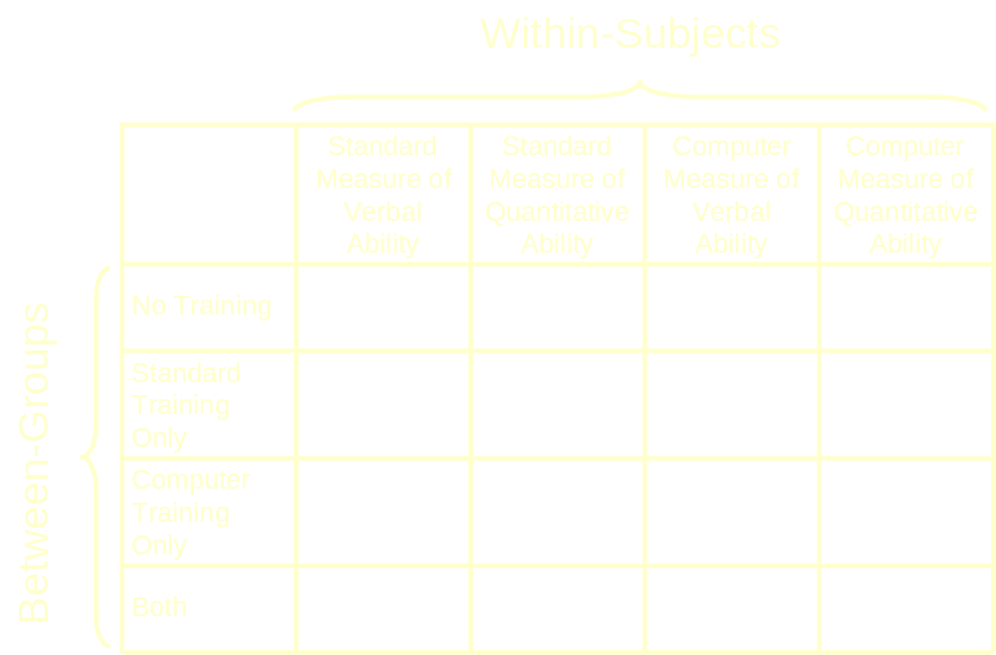
With 16 means, there are 15 degrees of freedom and a lot of choices for partitioning this variance.

Slide 7
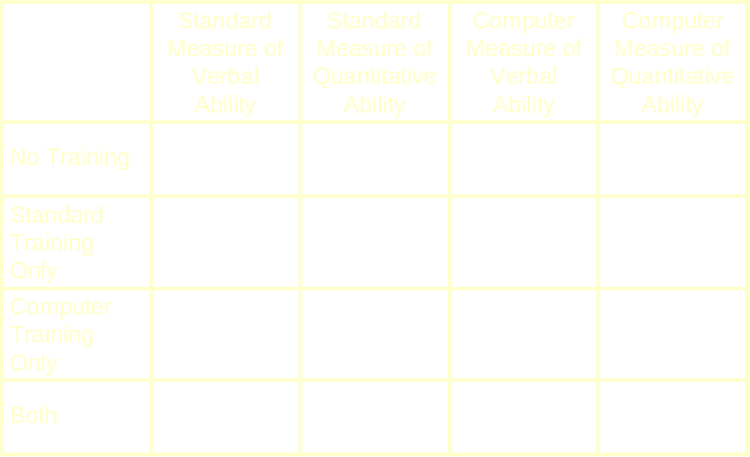
 | No Computer Training | Computer Training
No Standard Training
Standard Training
There is an inherent factorial structure to the groups. This structure can be incorporated into the analysis.

Slide 8
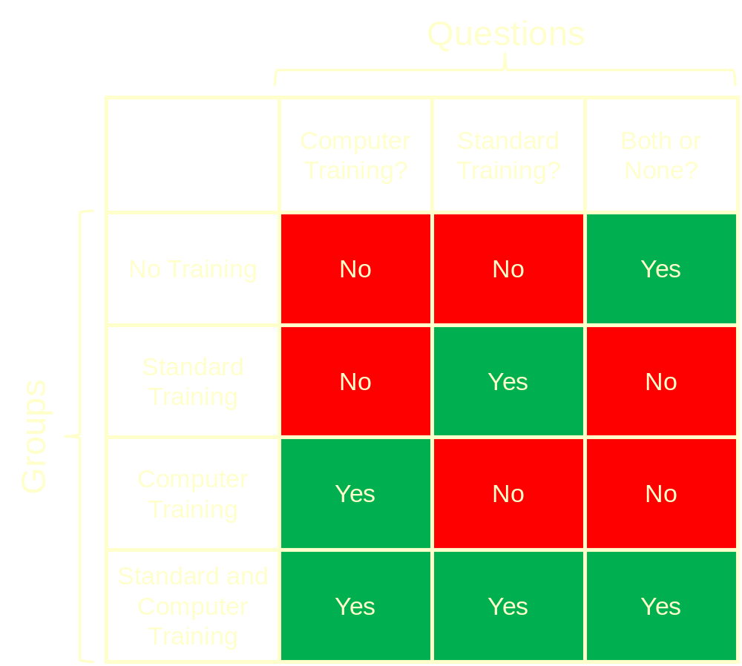

Slide 9
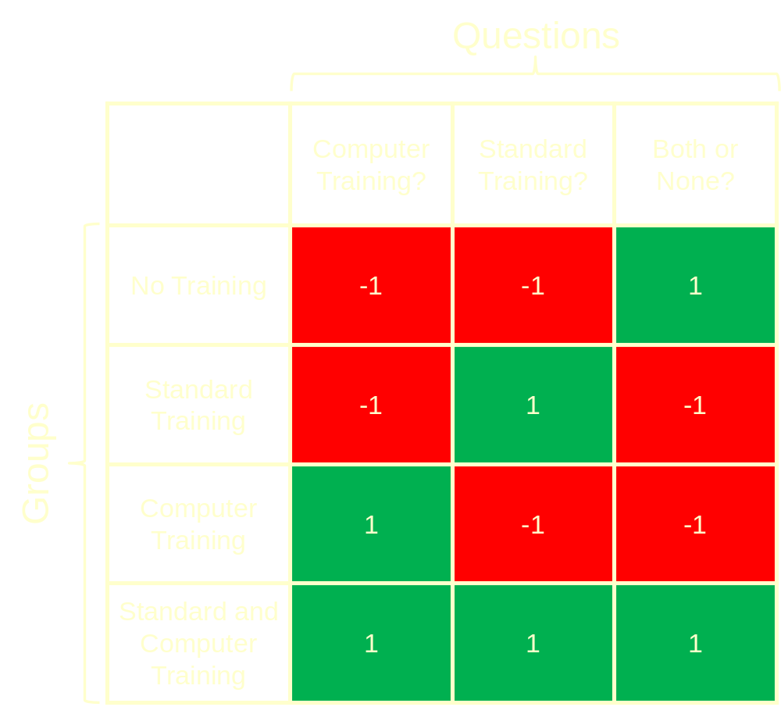

Slide 10
These contrast codes create three separate two-group comparisons. They are the standard main effects and interaction from ANOVA.

Slide 11
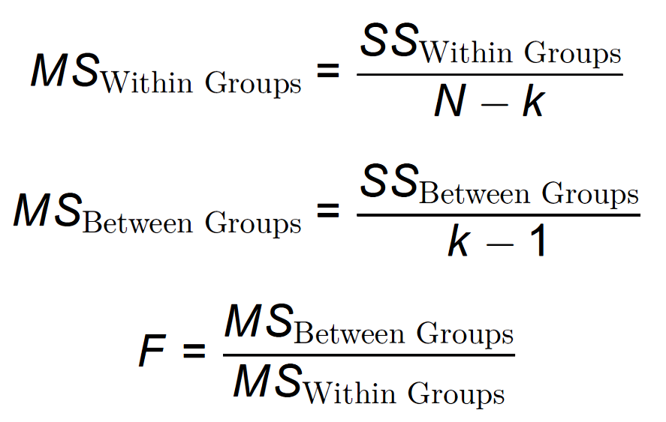
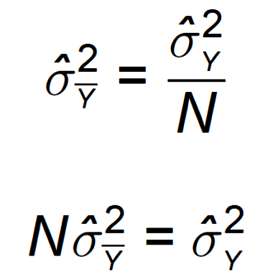
Group 1 | Group 2 | Group 3 | . . . | Group G
M₁ SD₁ | M₂ SD₂ | M₃ SD₄ |  | M_{G} SD_{G}

Slide 12
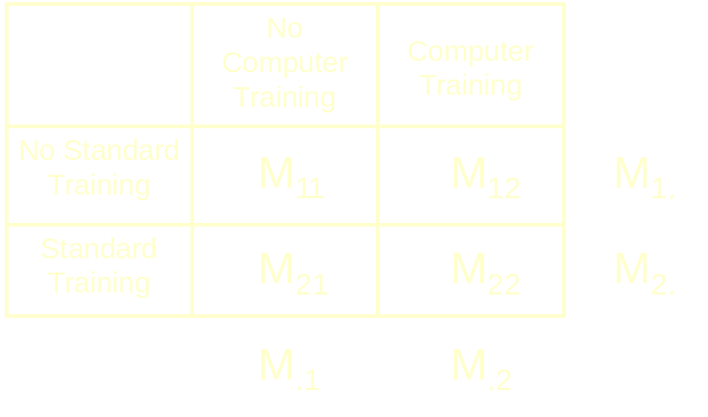
The same principles hold for factorial designs. The F statistic is the ratio of two estimates of random variability under the null hypothesis, with the numerator an estimate based on variability of means. The variability of means could be based on marginal means.

Slide 13
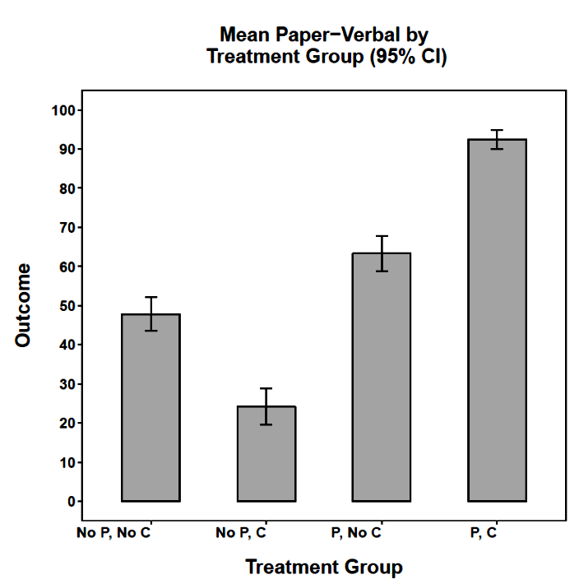
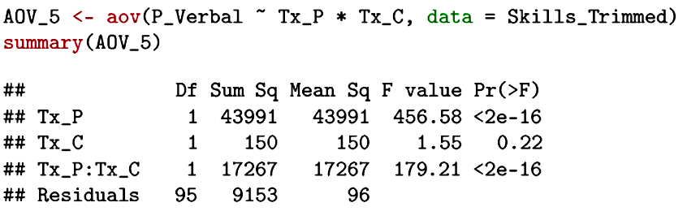

Slide 14
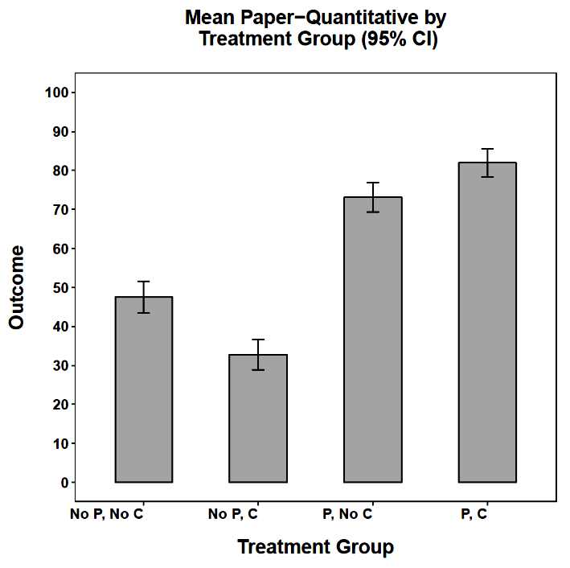
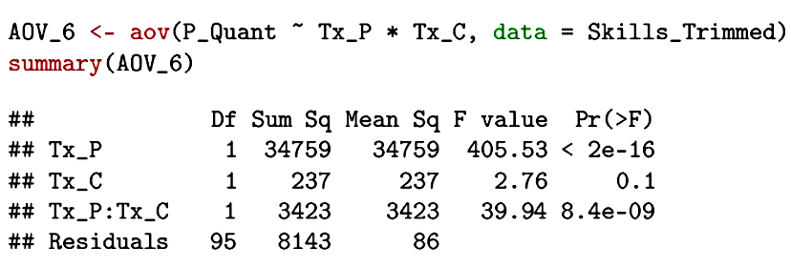

Slide 15
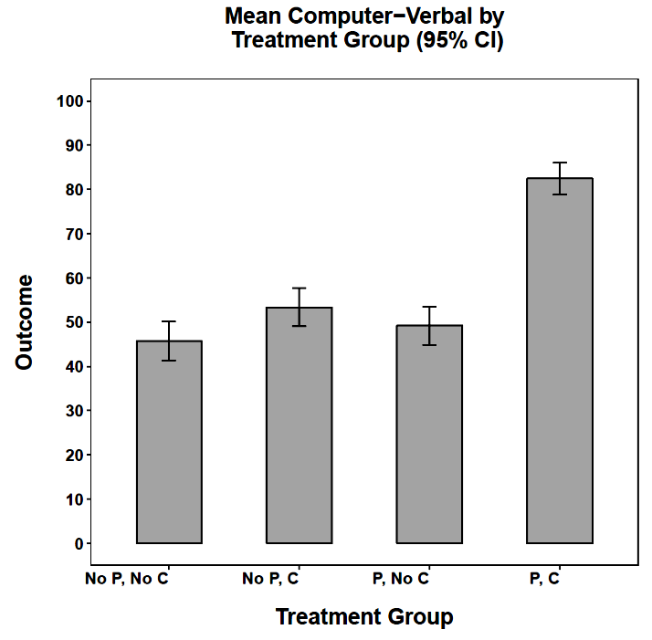
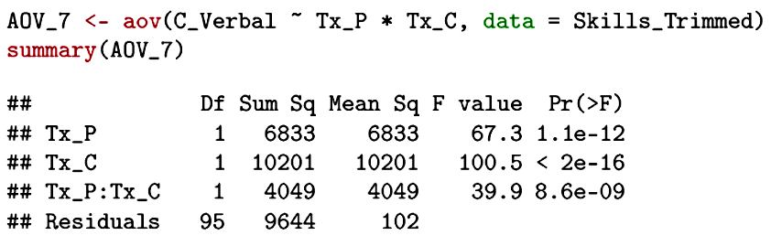

Slide 16
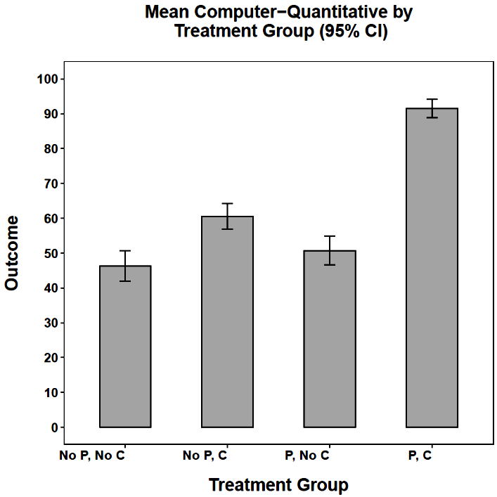
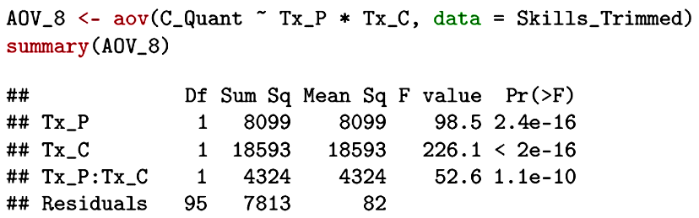

Slide 17
 | Verbal Ability | Quantitative Ability
Standard Measure
Computer Measure
The outcome measures also have an inherent structure that can be built into the analysis.

Slide 18
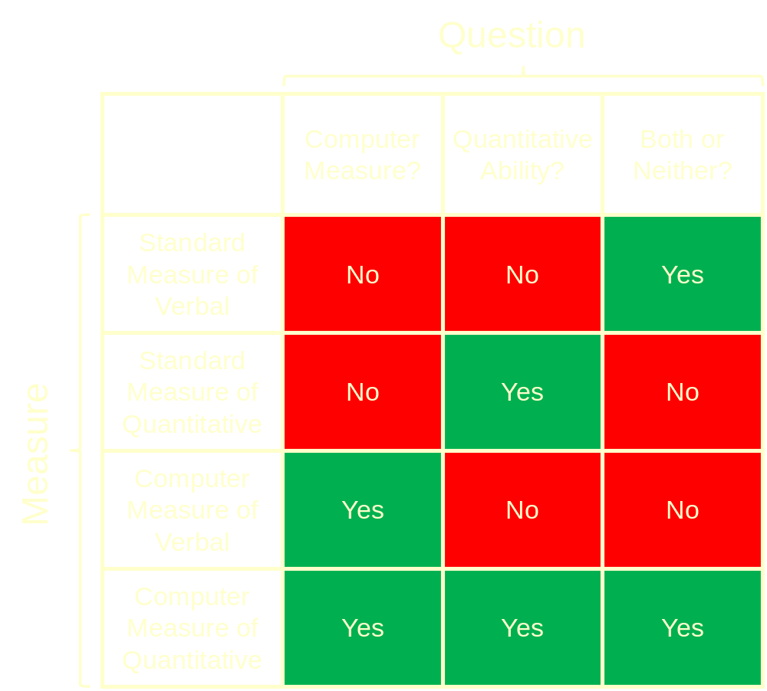

Slide 19


Slide 20
The contrasts create three new linear combinations of means. They represent the standard main effects and interaction from a repeated measures ANOVA. We can also simply sum the measures.

Slide 21
 | No Computer Training | Computer Training
No Standard Training
Standard Training
In combination, the two smaller designs create all main effects and interactions in the larger 2 x 2 x 2 x 2 design.
Each effect is a single degree of freedom—15 in all (4 main, 6 two-way, 4 three-way, 1 four-way).
X
 | Verbal Ability | Quantitative Ability
Standard Measure
Computer Measure

Slide 22
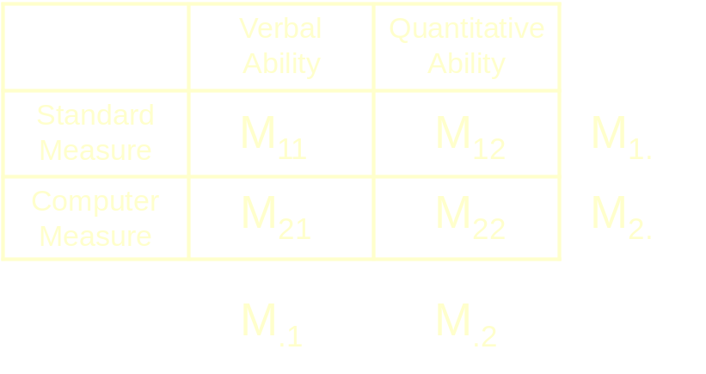
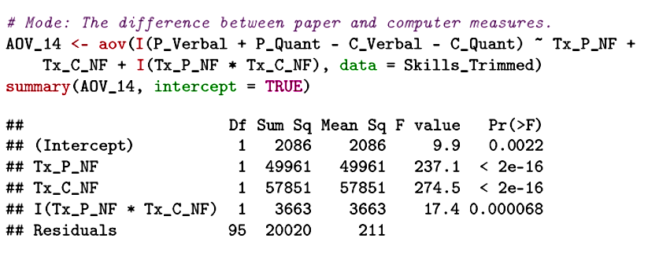
Note that when the linear combination has weights that sum to 0, the intercept is a meaningful test (a repeated measures main effect).

Slide 23
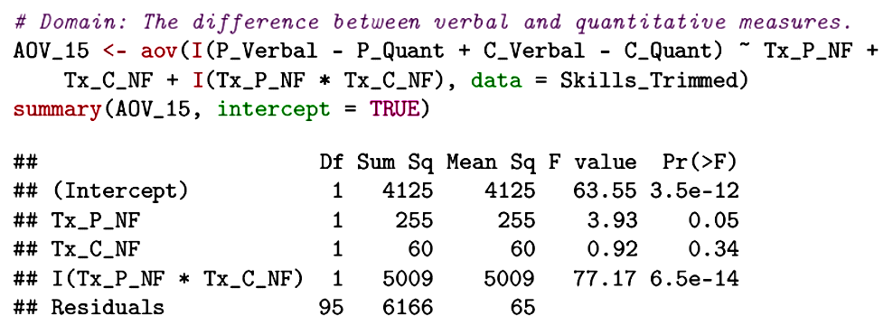
Now the linear combination is a test of verbal versus quantitative abilities.

Slide 24
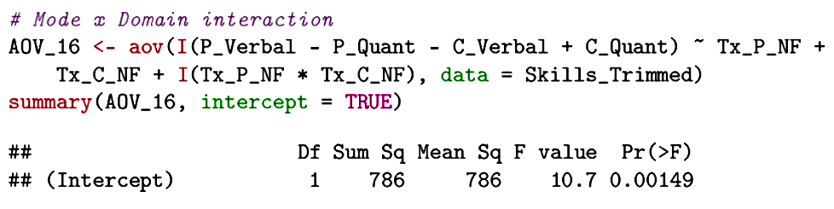
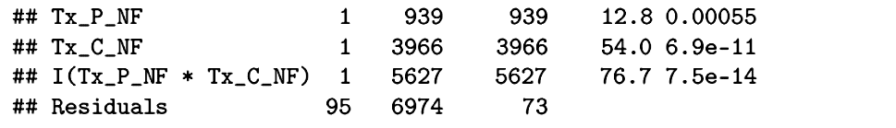
The outcome linear combination is the interaction in the within-subjects part of the design. All effects in this table are interactions.

Slide 25
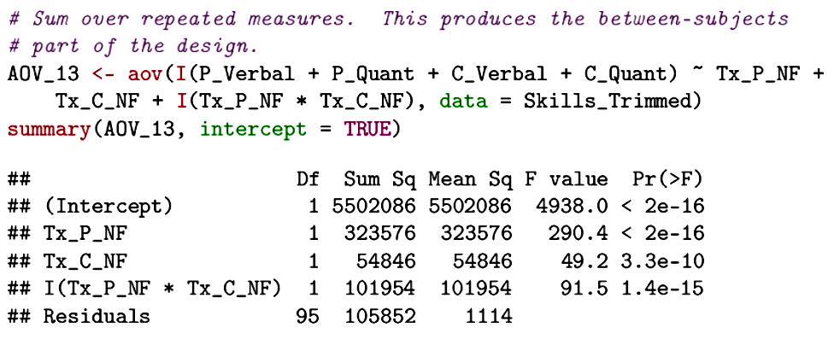
When the outcome measures are summed, the analysis becomes the between-groups part of the design. In this case, the intercept test is not meaningful. It merely tests if the grand mean is different from 0.

Slide 26
In a factorial, A x B, design, the sums of squares methods are:
  Type I SS:
    SS(A)
    SS(B|A)
    SS(AxB|A,B)
  Type II SS:
    SS(A|B)
    SS(B|A)
    SS(AxB|A,B)
  Type III SS
    SS(A|B,AxB)
    SS(B|A,AxB)
    SS(AxB|A,B)
Different functions in R will use different defaults. If the design is balanced, it won’t matter, but if the predictors are correlated, then this must be given some careful attention.

Slide 27
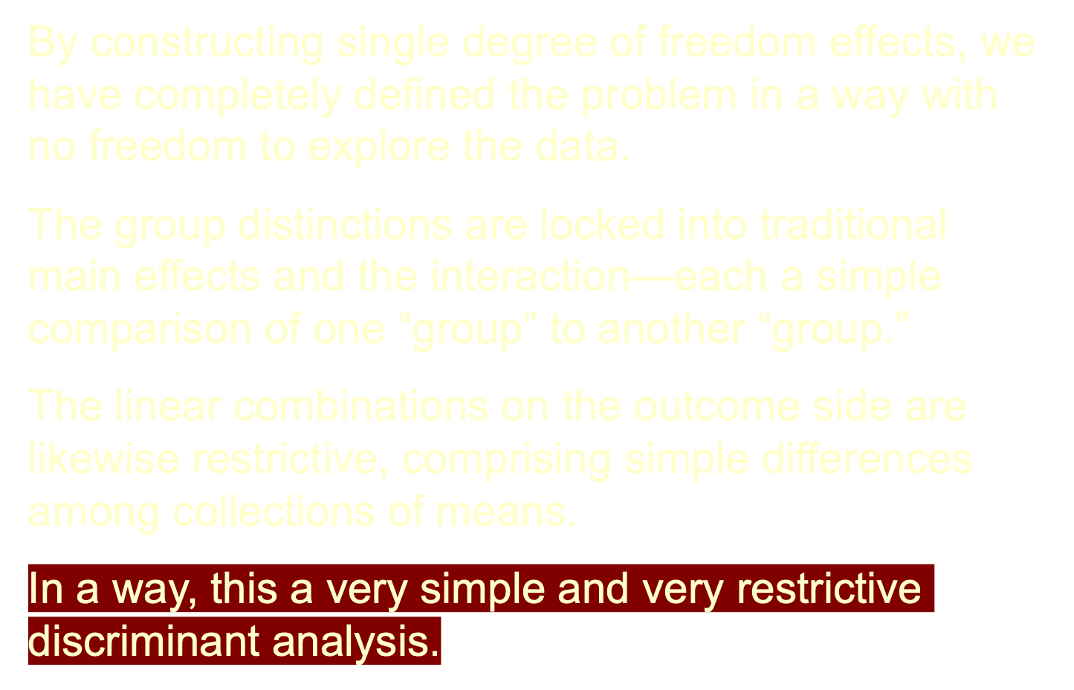

Slide 28
The factorial design imposes structure on the data.
How might we relax the restrictions on the dependent variable side to allow an alternative discriminant analysis?
How might we relax the restrictions on the independent variable side to allow an alternative discriminant analysis?
What do we lose by relaxing the restrictions imposed by the factorial designs?

Slide 29
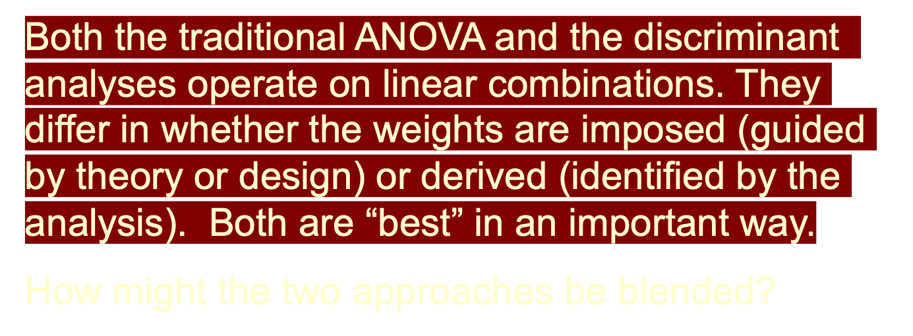
By relaxing the constraints imposed by both factorial designs, we arrive at a traditional discriminant analysis: “Are there linear combinations of the outcome variables that produce maximum separation of the groups?”

Slide 30
One difference between MANOVA and discriminant analysis is that the groups to be discriminated in MANOVA are often under experimental control.
A second (trivial) difference is that the groups are usually labeled as the independent variable rather than the outcome.
The goal, however, is the same: Find independent linear combinations of variables that best separate the groups (however they are defined).

Slide 31
MANOVA has traditionally relied on a broader number of statistical tests for determining the significance of the linear combinations and for determining the nature of the discrimination that is identified.
Four common tests of significance represent generalizations of the univariate approach to significance testing.
In the univariate model, an F test gauges the amount of between-groups variability to within-groups variability.

Slide 32
Group 1 | Group 2 | Group 3 | . . . | Group G
M₁ SD₁ | M₂ SD₂ | M₃ SD₄ |  | M_{G} SD_{G}

Slide 33
In the multivariate model, the single sums of squares are replaced by matrices of sums of squares and cross-products for the effect or hypothesis (H) and for error (E). Different combinations of these matrices define the four most common tests of significance:
  Roy’s test is a function of the largest eigenvalue of HE⁻¹
  Lawley and Hotelling’s Trace = tr(HE⁻¹)
  Pillai’s test is a function of tr(H(H+E)⁻¹)
  Wilk’s likelihood test is based on Λ = |E|/|H+E|
The latter three usually agree because they use much the same information.

Slide 34
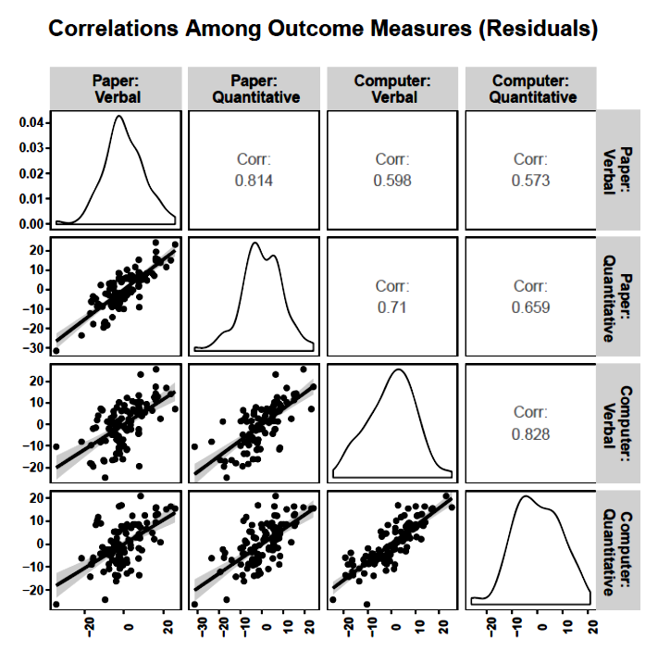
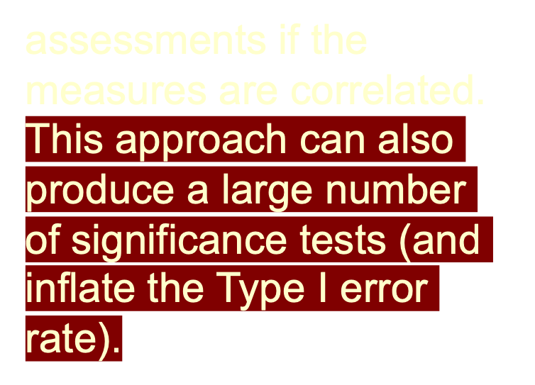
There are two other problems that MANOVA can help solve:
  The multiple ANOVAs approach, with each DV analyzed separately, produces a large number of significance tests. These tests will not produce independent

Slide 35
  The multiple outcomes may not be in the same metric, eliminating the repeated measures option. Even if in the same metric, the comparisons may not make conceptual sense. MANOVA provides additional interesting ways to view the data that overcome this “metric” problem.

Slide 36
Next time . . .
Example and extending the interpretations from discriminant analysis

